Slide 1
Group 5:
HW3 - JOINS
David Fazylov
Devak Mehta
Mret Hein Nadia Islam
Renzo Salazar Cueva

Slide 2
David Fazylov

Slide 3
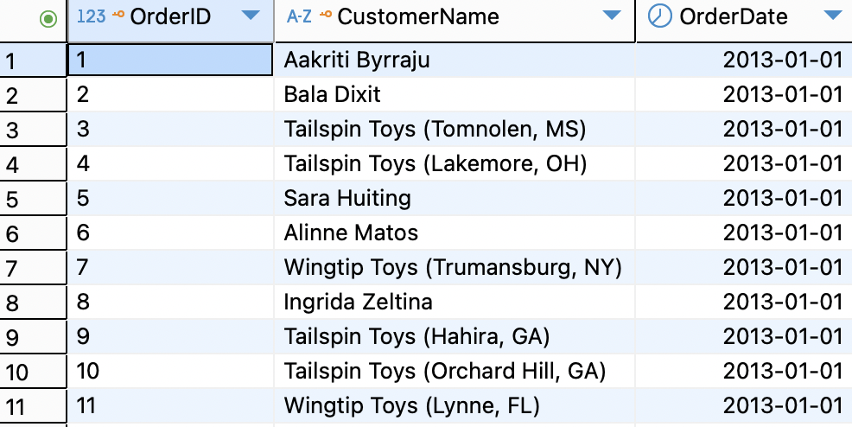
QUERY 1
SELECT o.OrderID, c.CustomerName, o.OrderDate
FROM Sales.Orders o
INNER JOIN Sales.Customers c
ON o.CustomerID = c.CustomerID;
Proposition:
Find all orders with their customer names.
Business Value:
This combines order details with customer information, so a sales team can easily see who placed each order. It supports better customer service and quick order lookups.
Why it’s Special:
I wanted to clearly identify which customers are generating orders, so its relatively easy to track things such as buying patterns, build stronger relationships, and provide personalized service.
Notes:
David Fazylov

Slide 4
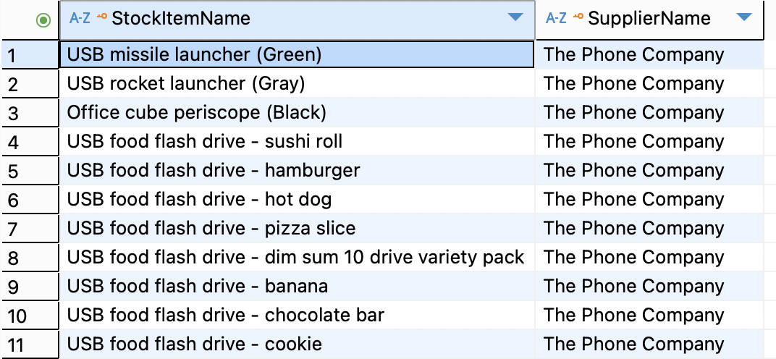
QUERY 2
SELECT si.StockItemName, s.SupplierName
FROM Warehouse.StockItems si
INNER JOIN Purchasing.Suppliers s
ON si.SupplierID = s.SupplierID;
Proposition:
Show products with their supplier names.
Business Value:
This query helps warehouse and purchasing teams know which supplier provides each item, making it easier to manage inventory, and sourcing of that inventory.
Why it's special:
As a manager, I want to quickly see which suppliers are tied to each product so I can ensure reliable supply, address issues with the correct vendor, and strengthen supplier partnerships.
Notes:
David Fazylov

Slide 5
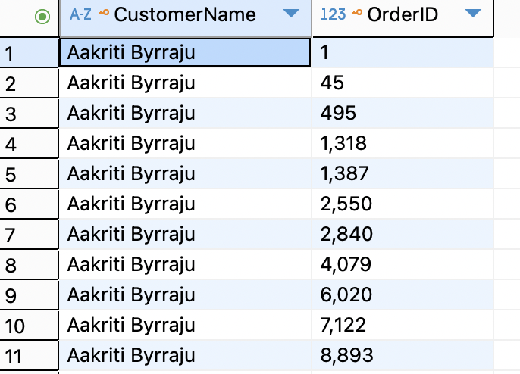
QUERY 3
SELECT c.CustomerName, o.OrderID
FROM Sales.Customers c
LEFT JOIN Sales.Orders o
ON c.CustomerID = o.CustomerID
ORDER BY c.CustomerName;
Proposition:
List all customers and their orders (including those who never ordered).
Business Value:
This query helps marketing teams identify inactive customers who may need special offers or outreach to encourage them to make purchases. It ensures visibility into both active and dormant customer relationships.
Why it’s special:
I want to see which customers are engaged and which ones are not, so I can focus s team’s marketing efforts on reactivating inactive customers and rewarding loyal ones.

Slide 6
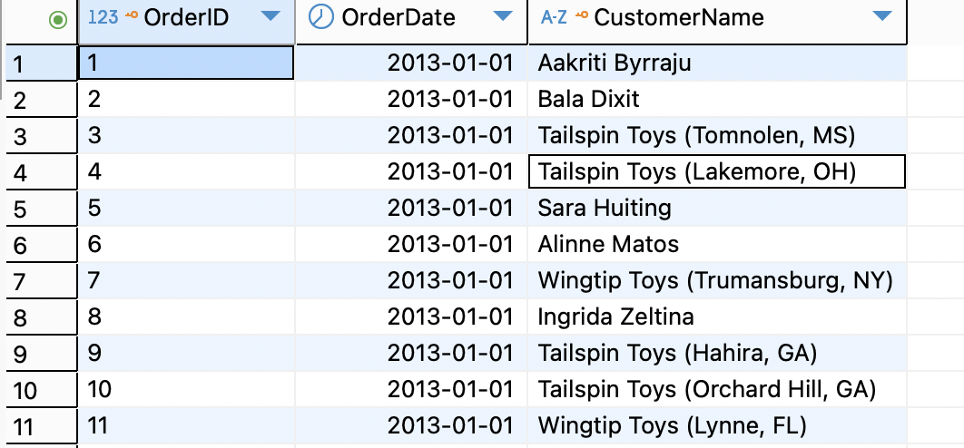
Query 4:
SELECT o.OrderID, o.OrderDate, c.CustomerName
FROM Sales.Orders o
RIGHT JOIN Sales.Customers c
ON o.CustomerID = c.CustomerID;
Proposition:
Find all orders and the customers (even if the customer record is missing).
Business Value:
This query ensures no orders are overlooked, even if some customer data has been deleted or is incomplete. It provides a fuller view of order activity without being limited by missing customer information.
Why It’s Special:
I want to make sure every order is accounted for, even if the customer’s record is missing, so I can maintain accurate sales reporting and follow up on any potential data quality issues.

Slide 7
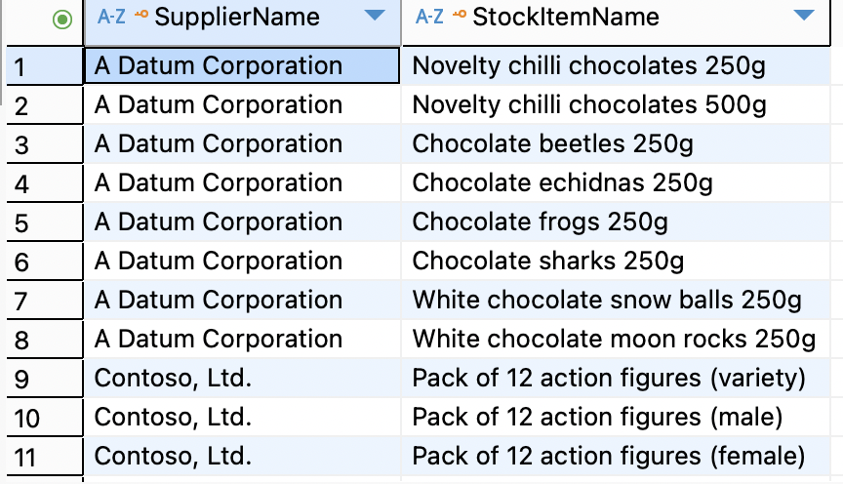
QUERY 5:
SELECT s.SupplierName, si.StockItemName
FROM Purchasing.Suppliers s
LEFT JOIN Warehouse.StockItems si
ON s.SupplierID = si.SupplierID;
Proposition:
Match suppliers to products, even if some suppliers provide nothing.
Business Value:
This query shows which suppliers are currently active and which ones are not supplying any products. It helps identify unused or inactive supplier relationships and ensures the purchasing team has full visibility into supplier activity.
Why It’s Special:
I want to see which suppliers are contributing and which ones are idle so I can prioritize partnerships with active vendors, renegotiate or phase out inactive suppliers, and improve supply chain efficiency.

Slide 8
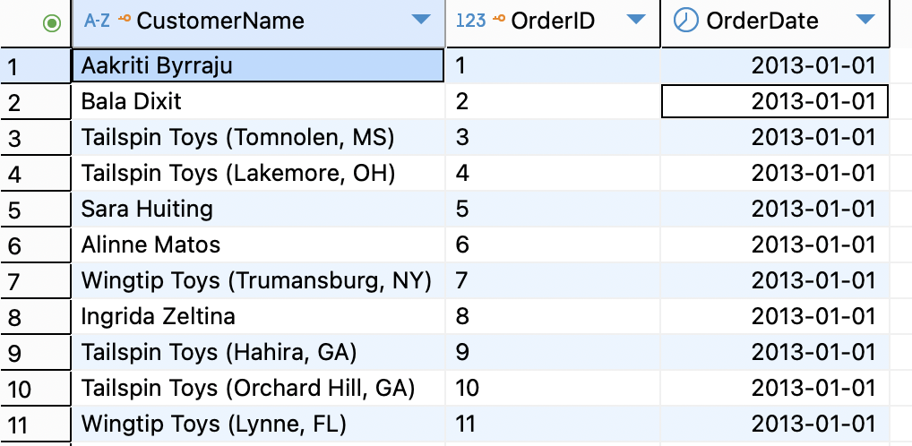
QUERY 6:
SELECT c.CustomerName, o.OrderID, o.OrderDate
FROM Sales.Customers c
FULL OUTER JOIN Sales.Orders o
ON c.CustomerID = o.CustomerID;
Proposition:
Full outer join between customers and orders.
Business Value:
This query gives a complete view of all customers and all orders, showing gaps on either side such as customers without orders and orders without matching customers. It ensures nothing is left out when analyzing customer activity.
Why It’s Special:
I want to see both active and inactive customers, as well as all orders regardless of whether they’re linked to valid customer records. This helps me identify new opportunities for engagement, spot any data inconsistencies, and keep a full picture of customer and order activity

Slide 9
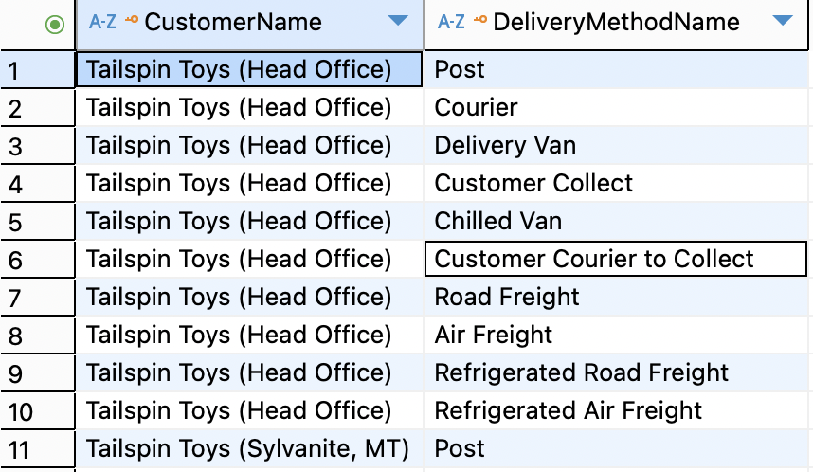
QUERY 7:
SELECT c.CustomerName, d.DeliveryMethodName
FROM Sales.Customers c
CROSS JOIN Application.DeliveryMethods d;
Proposition:
Cross join to explore all possible customer–delivery method pairs.
Business Value:
This query is useful for scenario testing (e.g., what if each customer used each delivery method?) and for coverage checks. It helps simulate possible combinations and ensures delivery options are considered for all customers.
Why It’s Special:
I want to see every potential pairing of customers and delivery methods so I can test different logistics scenarios, evaluate delivery coverage, and prepare for new service options without missing ANY possibilities.

Slide 10
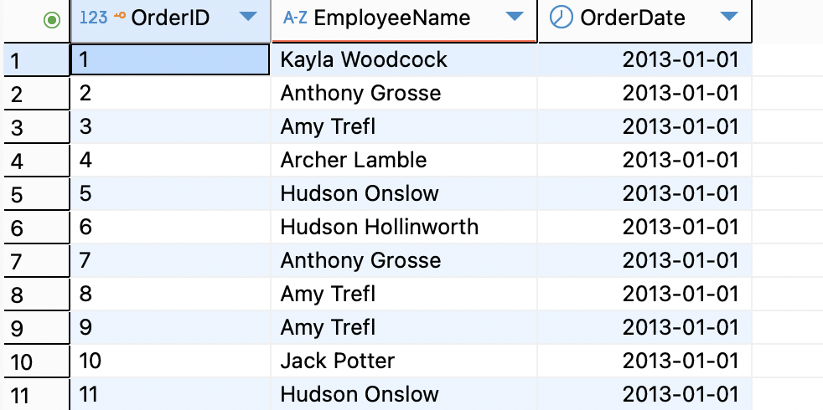
Query 8:
SELECT o.OrderID, p.FullName AS EmployeeName, o.OrderDate
FROM Sales.Orders o
INNER JOIN Application.People p
ON o.SalespersonPersonID = p.PersonID;
Proposition:
Find which employees processed which orders.
Business Value:
This query shows accountability and helps analyze workload across sales employees. It ensures management can track who is handling orders, evaluate performance, and distribute any tasks fairly.
Why It’s Special:
I want to see which employees are processing orders so I can measure productivity, identify top performers, and balance workloads more effectively across a sales team.

Slide 11
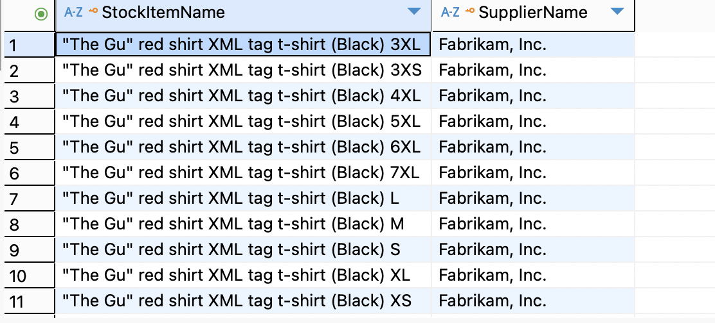
Query 9:
SELECT si.StockItemName, s.SupplierName
FROM Warehouse.StockItems si
INNER JOIN Purchasing.Suppliers s
ON si.SupplierID = s.SupplierID
ORDER BY si.StockItemName;
Proposition:
List all products and their suppliers.
Business Value:
This query helps the purchasing department quickly see which supplier is responsible for each product in the catalog. It is useful for supply chain tracking and ensures the right vendor can be contacted immediately if an issue arises with a product.
Why It’s Special:
I want a clear view of which supplier provides each product so my team can handle supply chain issues efficiently, maintain accountability, and strengthen vendor relationships.

Slide 12
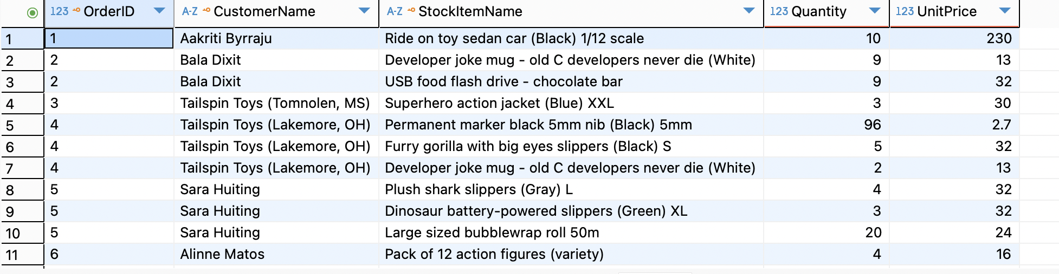
Query 10:
SELECT o.OrderID, c.CustomerName, si.StockItemName, ol.Quantity, ol.UnitPrice
FROM Sales.Orders o
INNER JOIN Sales.OrderLines ol
ON o.OrderID = ol.OrderID
INNER JOIN Warehouse.StockItems si
ON ol.StockItemID = si.StockItemID
INNER JOIN Sales.Customers c
ON o.CustomerID = c.CustomerID
ORDER BY o.OrderID;
Proposition:
Orders with product details (Orders + OrderLines + StockItems).
Business Value:
This query combines multiple tables to provide a full picture of what was ordered, by whom, and at what price. It supports detailed sales analysis, accurate invoicing, and better customer service by tying together all relevant order information.
Why It’s Special:
I want to see each order broken down by customer, product, quantity, and price so I can monitor sales trends, verify accuracy in billing, and make data-driven decisions about product performance and customer demand.

Slide 13
Devak Mehta
Notes:
Devak Mehta

Slide 14
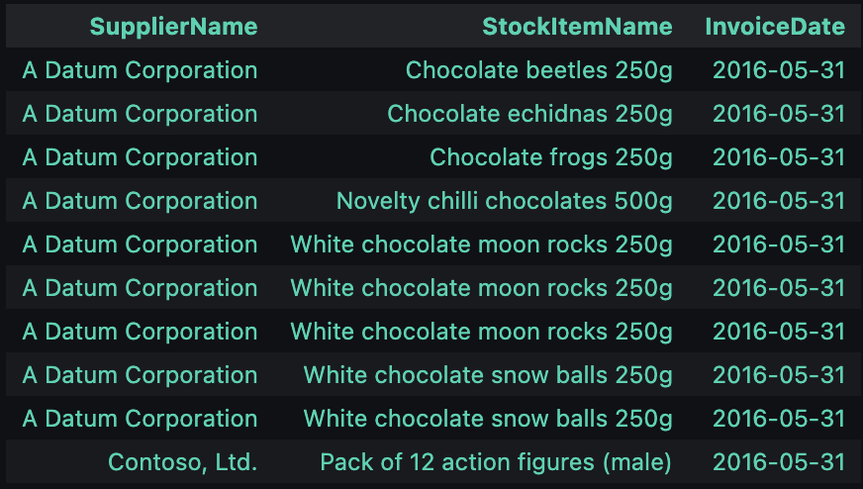
QUERY 1
%%sql
SELECT TOP (10)
s.SupplierName,
si.StockItemName,
i.InvoiceDate
FROM Purchasing.Suppliers AS s
JOIN Warehouse.StockItems AS si ON si.SupplierID = s.SupplierID
JOIN Sales.InvoiceLines AS il ON il.StockItemID = si.StockItemID
JOIN Sales.Invoices AS i ON i.InvoiceID = il.InvoiceID
WHERE i.InvoiceDate >= DATEADD(DAY, -30, (SELECT MAX(InvoiceDate) FROM Sales.Invoices))
ORDER BY i.InvoiceDate DESC, s.SupplierName, si.StockItemName;
-This query finds suppliers and the items they provided that generated sales in the most recent 30 days.
-It joins suppliers, stock items, invoice lines, and invoices to track who sold what and when.
-Useful for identifying active supplier–item relationships and recent product flow.
- imagined myself as the manager and wanted to see which supplier are recently or currently active to priortize relationships with such suppliers
Notes:
Devak Mehta

Slide 15
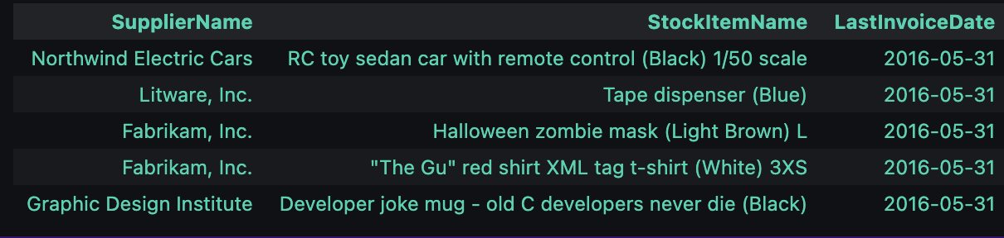
QUERY 2
%%sql
SELECT TOP(5)
s.SupplierName,
si.StockItemName,
MAX(i.InvoiceDate) AS LastInvoiceDate
FROM Purchasing.Suppliers AS s
JOIN Warehouse.StockItems AS si ON si.SupplierID = s.SupplierID
JOIN Sales.InvoiceLines AS il ON il.StockItemID = si.StockItemID
JOIN Sales.Invoices AS i ON i.InvoiceID = il.InvoiceID
WHERE i.InvoiceDate >= DATEADD(DAY, -180, (SELECT MAX(InvoiceDate) FROM Sales.Invoices))
GROUP BY s.SupplierName, si.StockItemName
ORDER BY LastInvoiceDate DESC;
-Finds the latest invoice date per supplier–item pair (last 180 days)
-Helps identify whether supplier–item combinations are still active
-Recent dates = active suppliers; older = inactive
-Useful for supplier monitoring, basically just like above wanted to see non so active suppliers so i could not rely on them
Notes:
Devak Mehta

Slide 16
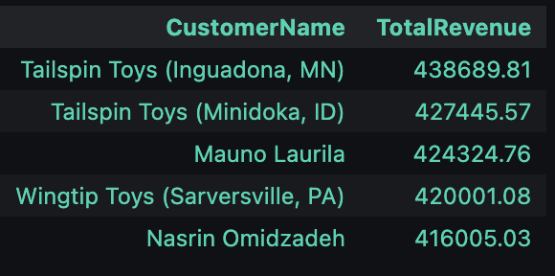
Query 3
%%sql
SELECT TOP(5)
c.CustomerName,
SUM(il.ExtendedPrice) AS TotalRevenue
FROM Sales.Invoices as i
JOIN Sales.InvoiceLines AS il ON il.InvoiceID = i.InvoiceID
JOIN Sales.Customers AS c ON c.CustomerID = i.CustomerID
GROUP BY c.CustomerName
ORDER BY TotalRevenue DESC;
-Shows top 5 customers by spending
-Useful for identifying VIP / high-value customers
-Helps focus marketing & loyalty programs
-Ranks by total revenue
-at first glance this query would seem similar to query 8 however this query is only to find out customer than spend a lot, for short term offers considering a startup company. Hence a simple join query

Slide 17
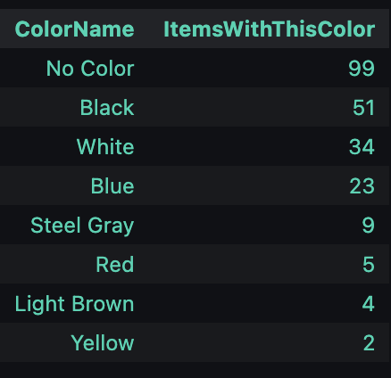
Query 4
%%sql
SELECT TOP (10)
COALESCE(col.ColorName, 'No Color') AS ColorName,
COUNT(*) AS ItemsWithThisColor
FROM Warehouse.StockItems AS si
LEFT JOIN Warehouse.Colors AS col ON col.ColorID = si.ColorID
GROUP BY COALESCE(col.ColorName, 'No Color')
ORDER BY ItemsWithThisColor DESC, ColorName;
-Shows how many items exist for each color
-Uses COALESCE to label nulls as “No Color”(i learned about COALESCE while i was studying pandas as it had a .fillna() so i thought sql might have something too fill none with a label and found out about it in freecodecamp Sql lessons. )
-Useful for inventory diversity analysis

Slide 18
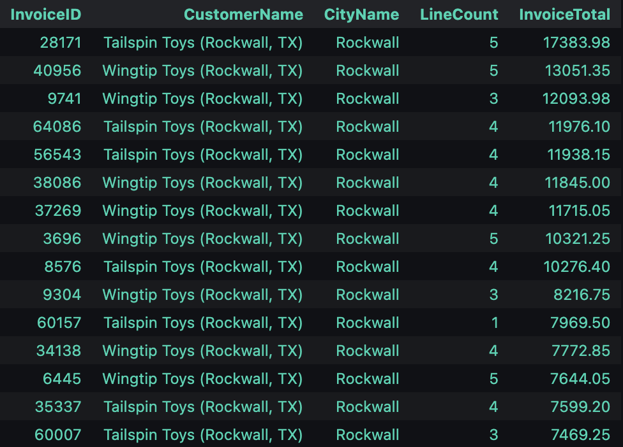
Query 5
%%sql
SELECT TOP (15)
i.InvoiceID,
c.CustomerName,
ci.CityName,
COUNT(il.InvoiceLineID) AS LineCount,
SUM(il.ExtendedPrice) AS InvoiceTotal
FROM Sales.Invoices AS i
JOIN Sales.Customers AS c ON c.CustomerID = i.CustomerID
JOIN Application.Cities AS ci ON ci.CityID = c.DeliveryCityID
LEFT JOIN Sales.InvoiceLines AS il ON il.InvoiceID = i.InvoiceID
WHERE ci.CityName = 'New York' OR ci.CityName = 'Rockwall'
GROUP BY i.InvoiceID, c.CustomerName, ci.CityName
ORDER BY InvoiceTotal DESC;
-Retrieves invoices, customer, city, line count, and totals
-Focuses on a specific city (example: Rockwall)
-Useful for analyzing city-level sales activity
-Helps compare sales between locations
-for this query i just wanted to do new york first to show that how a company would want to see if they have no business in certain states in this case new york and hence want to expand but the idea of returning 0 tables didnt feel right so i added Rockwall

Slide 19
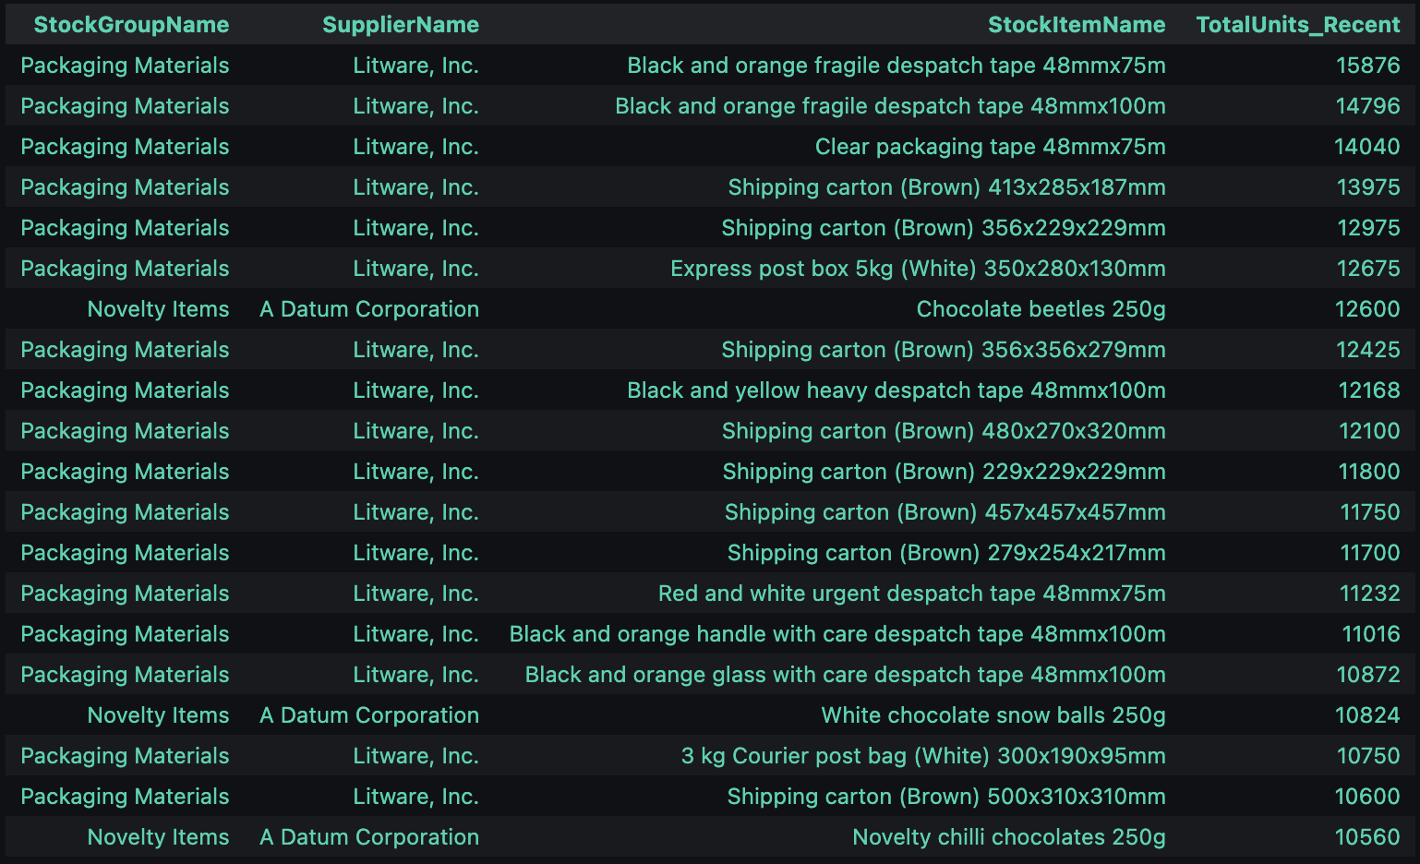
Query 6
%%sql
SELECT TOP (20)
sg.StockGroupName,
s.SupplierName,
si.StockItemName,
SUM(il.Quantity) AS TotalUnits_Recent
FROM Warehouse.StockItems AS si
JOIN Purchasing.Suppliers AS s ON s.SupplierID = si.SupplierID
LEFT JOIN Warehouse.StockItemStockGroups AS sisg ON sisg.StockItemID = si.StockItemID
LEFT JOIN Warehouse.StockGroups AS sg ON sg.StockGroupID = sisg.StockGroupID
JOIN Sales.InvoiceLines AS il ON il.StockItemID = si.StockItemID
JOIN Sales.Invoices AS i ON i.InvoiceID = il.InvoiceID
WHERE i.InvoiceDate >= DATEADD(DAY, -90, (SELECT MAX(InvoiceDate) FROM Sales.Invoices))
GROUP BY sg.StockGroupName, s.SupplierName, si.StockItemName
HAVING SUM(il.Quantity) > 1000
ORDER BY TotalUnits_Recent DESC;
-Finds stock groups & suppliers with high sales in last 90 days
-Filters to items with >1000 units sold
-Shows most popular and in-demand products
-Useful for inventory planning
- i wanted to use left join as i read it in the book and wanted to test it out

Slide 20
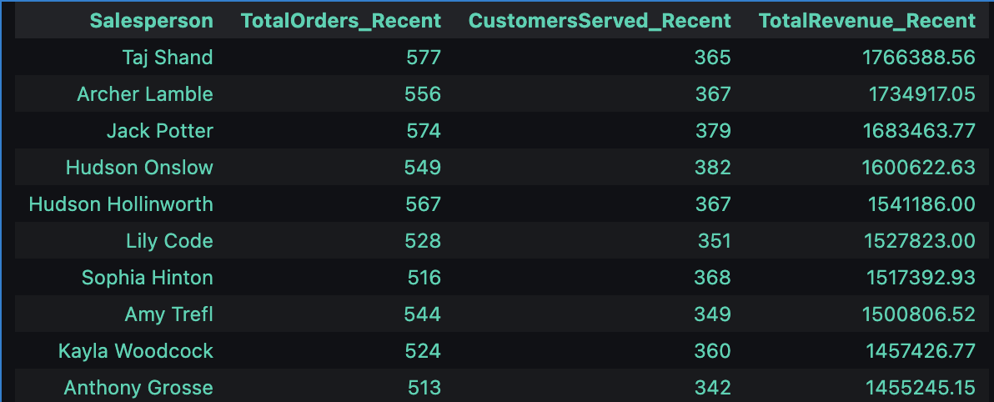
Query 7
%%sql
SELECT TOP (10)
p.FullName AS Salesperson,
COUNT(DISTINCT o.OrderID) AS TotalOrders_Recent,
COUNT(DISTINCT o.CustomerID) AS CustomersServed_Recent,
SUM(il.ExtendedPrice) AS TotalRevenue_Recent
FROM Sales.Orders AS o
JOIN Application.People AS p ON p.PersonID = o.SalespersonPersonID
JOIN Sales.Invoices AS i ON i.OrderID = o.OrderID
JOIN Sales.InvoiceLines AS il ON il.InvoiceID = i.InvoiceID
WHERE o.OrderDate >= DATEADD(DAY, -90, (SELECT MAX(OrderDate) FROM Sales.Orders))
GROUP BY p.FullName
ORDER BY TotalRevenue_Recent DESC;
-Shows salesperson performance in last 90 days
-Includes orders, customers served, and revenue
-Useful for ranking top salespeople

Slide 21
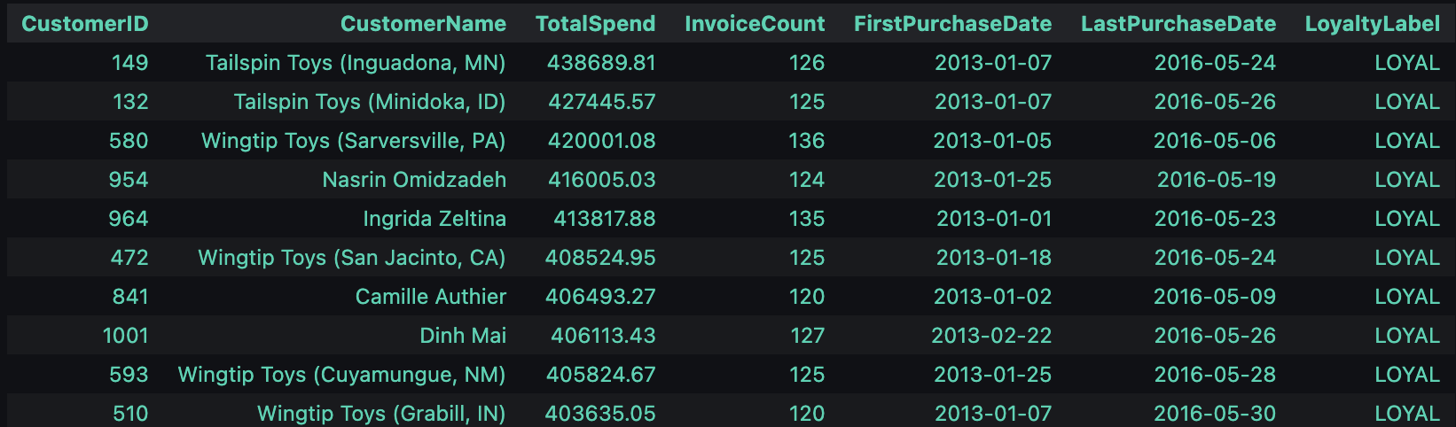
Query 8
%%sql
SELECT
c.CustomerID,
c.CustomerName,
SUM(il.ExtendedPrice) AS TotalSpend,
COUNT(DISTINCT i.InvoiceID) AS InvoiceCount,
MIN(i.InvoiceDate) AS FirstPurchaseDate,
MAX(i.InvoiceDate) AS LastPurchaseDate,
'LOYAL' AS LoyaltyLabel
FROM Sales.Customers AS c
JOIN Sales.Invoices AS i ON i.CustomerID = c.CustomerID
JOIN Sales.InvoiceLines AS il ON il.InvoiceID = i.InvoiceID
GROUP BY c.CustomerID, c.CustomerName
HAVING
COUNT(DISTINCT i.InvoiceID) >= 120
AND SUM(il.ExtendedPrice) > 400000
ORDER BY TotalSpend DESC;
-Identifies loyal, high-spending customers
-Loyalty: ≥120 invoices + spend >400k
-Labels them as “LOYAL”
-Useful for long-term customer retention strategies unlike query 3
-Query 3 = Who spent the most (single dimension: revenue).
Query 8 = Who spent the most and kept coming back (multi-dimension: revenue + loyalty thresholds) and i wanted to show the difference by doing this query
- chose those number because thats what yielded me a smaller sample, i didnt want to label numerous customers as loyal but only a few so i made the numbers according to that and hence the AND operator

Slide 22
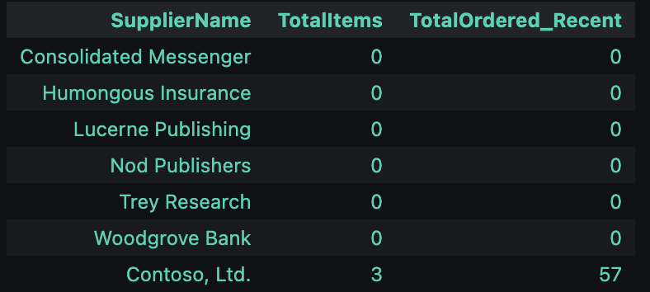
Query 9
%%sql
SELECT TOP (15)
s.SupplierName,
COUNT(si.StockItemID) AS TotalItems,
ISNULL(SUM(pol.OrderedOuters), 0) AS TotalOrdered_Recent
FROM Purchasing.Suppliers AS s
LEFT JOIN Warehouse.StockItems AS si
ON si.SupplierID = s.SupplierID
LEFT JOIN Purchasing.PurchaseOrderLines AS pol
ON pol.StockItemID = si.StockItemID
LEFT JOIN Purchasing.PurchaseOrders AS po
ON po.PurchaseOrderID = pol.PurchaseOrderID
AND po.OrderDate >= DATEADD(DAY, -365, (SELECT MAX(OrderDate) FROM Purchasing.PurchaseOrders))
GROUP BY s.SupplierName
HAVING COUNT(si.StockItemID) = 0 OR SUM(pol.OrderedOuters) < 100
ORDER BY TotalOrdered_Recent ASC, s.SupplierName;
-Finds suppliers with very few or no orders in the last year
-Useful for detecting inactive suppliers
-Helps managers decide whether to drop or re-negotiate suppliers
-Ensures inventory isn’t tied to unreliable suppliers. This was supposed to the opposite of above query.
-m

Slide 23
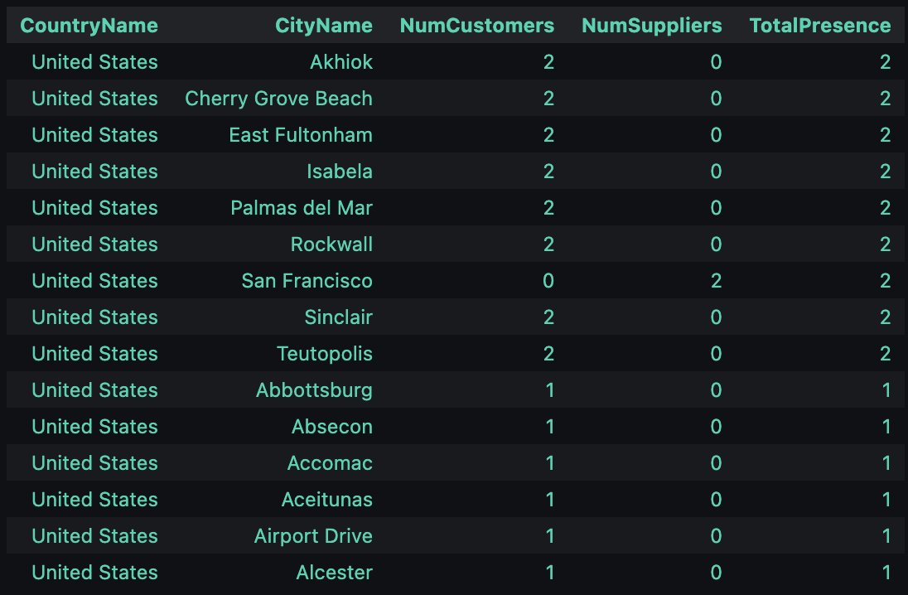
Query 10
%%sql
SELECT TOP (15)
co.CountryName,
ci.CityName,
COUNT(DISTINCT c.CustomerID) AS NumCustomers,
COUNT(DISTINCT s.SupplierID) AS NumSuppliers,
COUNT(DISTINCT c.CustomerID) + COUNT(DISTINCT s.SupplierID) AS TotalPresence
FROM Application.Countries AS co
JOIN Application.StateProvinces sp ON sp.CountryID = co.CountryID
JOIN Application.Cities ci ON ci.StateProvinceID = sp.StateProvinceID
LEFT JOIN Sales.Customers c ON c.DeliveryCityID = ci.CityID
LEFT JOIN Purchasing.Suppliers s ON s.DeliveryCityID = ci.CityID
GROUP BY co.CountryName, ci.CityName
HAVING COUNT(DISTINCT c.CustomerID) > 0
OR COUNT(DISTINCT s.SupplierID) > 0
ORDER BY TotalPresence DESC, co.CountryName, ci.CityName;
-Shows cities and countries with customer/supplier presence
-Calculates number of customers, suppliers, and total presence
-Useful for identifying business geographic hotspots
-Helps decide where to expand or focus resources

Slide 24
Mret Hein
Notes:
Mret Hein

Slide 25
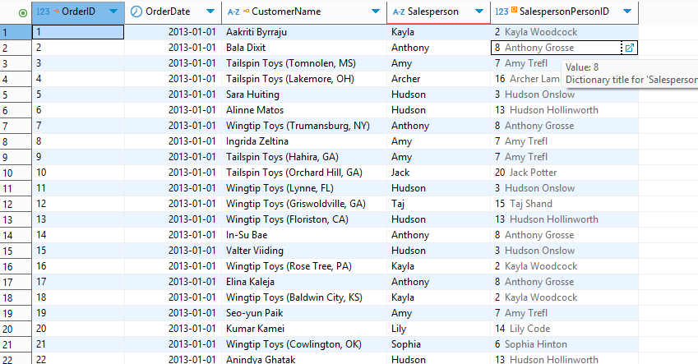
QUERY 1
-See the customers and their respective sales persons
SELECT
o.OrderID,
o.OrderDate,
c.CustomerName,
sp.PreferredName AS Salesperson,
o.SalespersonPersonID
FROM Sales.Orders AS o
JOIN Sales.Customers AS c
ON c.CustomerID = o.CustomerID
JOIN Application.People AS sp
ON sp.PersonID = o.SalespersonPersonID
ORDER BY o.OrderDate, o.OrderID;
A simple “who bought what and who sold it” view
Good for sales activity reports, filtering by date ranges, or grouping to see orders per salesperson/customer.
Notes:
Mret Hein

Slide 26
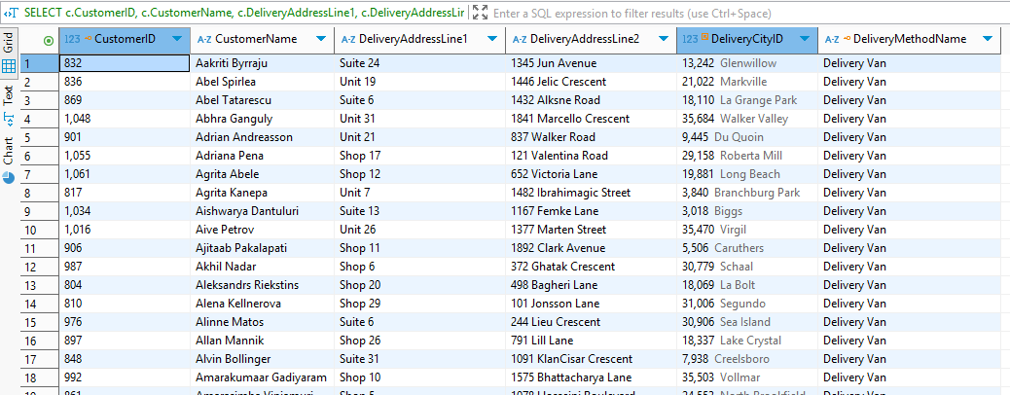
QUERY 2
-Customers whose default delivery method is “Delivery Van”
SELECT
c.CustomerID,
c.CustomerName,
c.DeliveryAddressLine1,
c.DeliveryAddressLine2,
c.DeliveryCityID,
dm.DeliveryMethodName
FROM Sales.Customers AS c
JOIN Application.DeliveryMethods AS dm
ON dm.DeliveryMethodID = c.DeliveryMethodID
WHERE dm.DeliveryMethodName = N'Delivery Van'
ORDER BY c.CustomerName;
Build up on my previous homework
Useful for logistics department
Can aid in tracking down the address if last min delivery changes need to be made
Notes:
Mret Hein

Slide 27
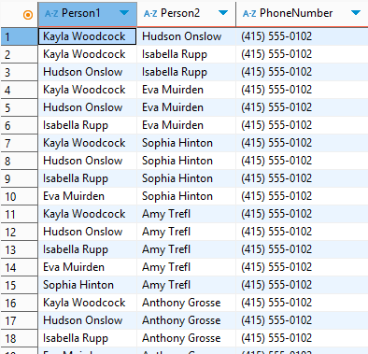
QUERY 3
-Find pairs of people with the same phone number
SELECT
p1.FullName AS Person1,
p2.FullName AS Person2,
p1.PhoneNumber
FROM Application.People AS p1
JOIN Application.People AS p2
ON p1.PhoneNumber = p2.PhoneNumber
WHERE p1.PersonID < p2.PersonID;
A simple “who has same phone number with who ” view
Single table join, but does not match the same person because of < operator
Useful for detecting which phone number is a duplicate among a pair of people so that we can check for possible errors in data typing
Notes:
Mret Hein

Slide 28
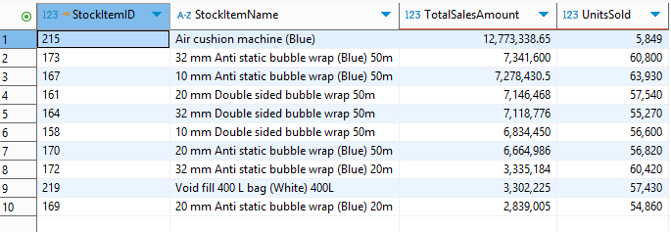
QUERY 4
-Top 10 stocks in warehouse by total sales amount (revenue)
SELECT TOP (10)
si.StockItemID,
si.StockItemName,
SUM(il.ExtendedPrice) AS TotalSalesAmount,
SUM(il.Quantity) AS UnitsSold
FROM Sales.InvoiceLines AS il
JOIN Sales.Invoices AS i
ON i.InvoiceID = il.InvoiceID
JOIN Warehouse.StockItems AS si
ON si.StockItemID = il.StockItemID
GROUP BY si.StockItemID, si.StockItemName
ORDER BY TotalSalesAmount DESC, si.StockItemName;
Quickly answers “What are our best-selling products?” by revenue.
The UnitsSold column lets you see volume vs. value (e.g., high revenue from high price vs. high quantity).
Useful in determining business strategies on deciding which products we should prioritize selling
Notes:
Mret Hein

Slide 29
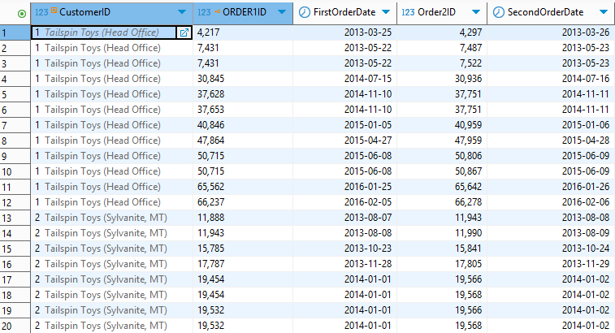
QUERY 5
-Find customers who have shipments on consecutive days
SELECT
o1.CustomerID,
o1.OrderID AS ORDER1ID,
o1.OrderDate AS FirstOrderDate,
o2.OrderID AS Order2ID,
o2.OrderDate AS SecondOrderDate
FROM Sales.Orders AS o1
JOIN Sales.Orders AS o2
ON o1.CustomerID = o2.CustomerID
WHERE DATEDIFF(day, o1.OrderDate, o2.OrderDate) = 1;
This query can help identify customers with high-volume, consecutive orders.
Finds back-to-back purchasing behavior (engagement bursts, potential subscription-like patterns).
Good for retention/marketing triggers (customers active two days in a row).
Notes:
Mret Hein

Slide 30
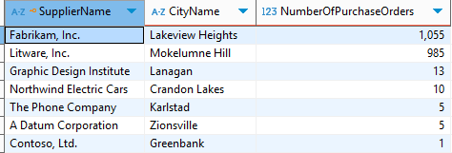
QUERY 6
-Show all suppliers, their corresponding cities, and no. of purchase orders
SELECT
s.SupplierName,
c.CityName,
COUNT(po.PurchaseOrderID) AS NumberOfPurchaseOrders
FROM Purchasing.Suppliers AS s
JOIN Purchasing.PurchaseOrders AS po
ON s.SupplierID = po.SupplierID
JOIN Application.Cities AS c
ON s.DeliveryCityID = c.CityID
GROUP BY
s.SupplierName,
c.CityName
ORDER BY
NumberOfPurchaseOrders DESC;
Useful for tracking down top suppliers who we get our supplies most from
Can determine better strategies for logistics as city names are revealed
Notes:
Mret Hein

Slide 31
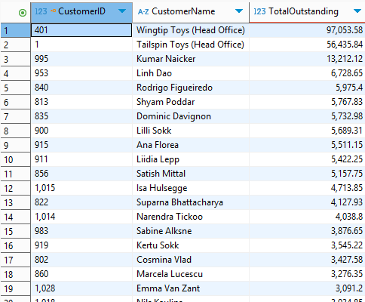
QUERY 7
-Top debtors
SELECT
c.CustomerID,
c.CustomerName,
SUM(ct.OutstandingBalance) AS TotalOutstanding
FROM Sales.CustomerTransactions AS ct
JOIN Sales.Customers AS c ON c.CustomerID = ct.CustomerID
WHERE ct.OutstandingBalance > 0
GROUP BY c.CustomerID, c.CustomerName
ORDER BY TotalOutstanding DESC, c.CustomerName;
Shows total open balance per customer
Good for accounting department (accounts receivable) for tracking down and getting the unpaid balance
Helpful for making better business strategies for maintaining relationships
Notes:
Mret Hein

Slide 32
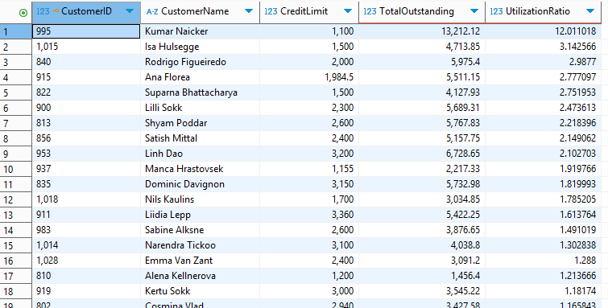
QUERY 8
-See customers and their credit utilization
SELECT
c.CustomerID,
c.CustomerName,
c.CreditLimit,
SUM(ct.OutstandingBalance) AS TotalOutstanding,
SUM(ct.OutstandingBalance) / c.CreditLimit AS UtilizationRatio
FROM Sales.Customers AS c
LEFT JOIN Sales.CustomerTransactions AS ct
ON ct.CustomerID = c.CustomerID AND ct.OutstandingBalance > 0
GROUP BY c.CustomerID, c.CustomerName, c.CreditLimit
ORDER BY UtilizationRatio DESC, TotalOutstanding DESC, c.CustomerName;
Credit utilization = Open Balance / Credit Limit
Higher Ratio = Higher Credit Utilization = Higher Risk!
Collections & credit control: surfaces customers near/over their limits to prioritize outreach.
Ranks exposure quickly without reading individual invoices.
Notes:
Mret Hein

Slide 33
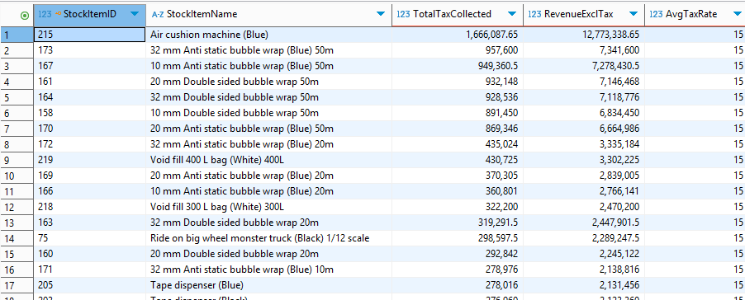
QUERY 9
-Top items by total tax collected
SELECT
si.StockItemID,
si.StockItemName,
SUM(il.TaxAmount) AS TotalTaxCollected,
SUM(il.ExtendedPrice) AS RevenueExclTax,
AVG(il.TaxRate) AS AvgTaxRate
FROM Sales.InvoiceLines AS il
JOIN Sales.Invoices AS i ON i.InvoiceID = il.InvoiceID
JOIN Warehouse.StockItems AS si ON si.StockItemID = il.StockItemID
GROUP BY si.StockItemID, si.StockItemName
ORDER BY TotalTaxCollected DESC, si.StockItemName;
Identifies which products drive the most tax
Pricing/tax policy review
Spotting high-impact items for audits
Notes:
Mret Hein

Slide 34
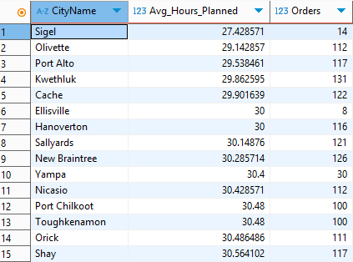
QUERY 10
-Planned average time by city (in hours)
SELECT
ci.CityName,
AVG(DATEDIFF(minute, o.OrderDate, o.ExpectedDeliveryDate) / 60.0) AS Avg_Hours_Planned,
COUNT(*) AS Orders
FROM Sales.Orders AS o
JOIN Sales.Customers AS c ON c.CustomerID = o.CustomerID
JOIN Application.Cities AS ci ON ci.CityID = c.DeliveryCityID
WHERE o.OrderDate IS NOT NULL
AND o.ExpectedDeliveryDate IS NOT NULL
AND o.ExpectedDeliveryDate >= o.OrderDate
GROUP BY ci.CityName
ORDER BY Avg_Hours_Planned ASC, ci.CityName;
Avg time = OrderDate → ExpectedDeliveryDate
Gives ops/logistics a city-level contract view of planned lead times.
Good baseline to compare against actuals (Order→Invoice) to spot cities running late.
Note: Queries 8,9 & 10 are aided by an LLM (ChatGPT) but some adjustments and code testings were made by myself
Notes:
Mret Hein

Slide 35
Renzo Salazar

Slide 36
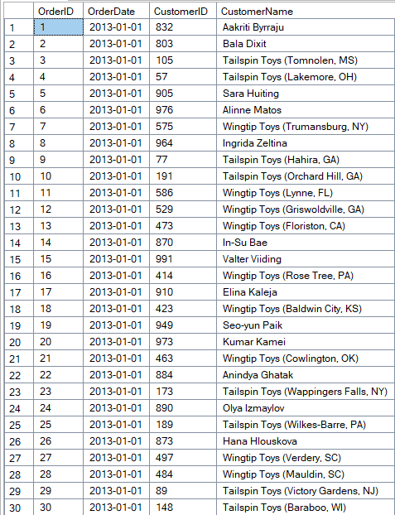
QUERY 1
Simple view of who ordered what and when.
Links order activity and Customer IDs to actual customer names.
We can use this data to see which customers placed the most orders and also easily see repeat customers.
USE WideWorldImporters;
GO
SELECT
o.OrderID,
o.OrderDate,
c.CustomerID,
c.CustomerName
FROM Sales.Orders AS o
INNER JOIN Sales.Customers AS c
ON c.CustomerID = o.CustomerID;
Notes:
Renzo Salazar

Slide 37
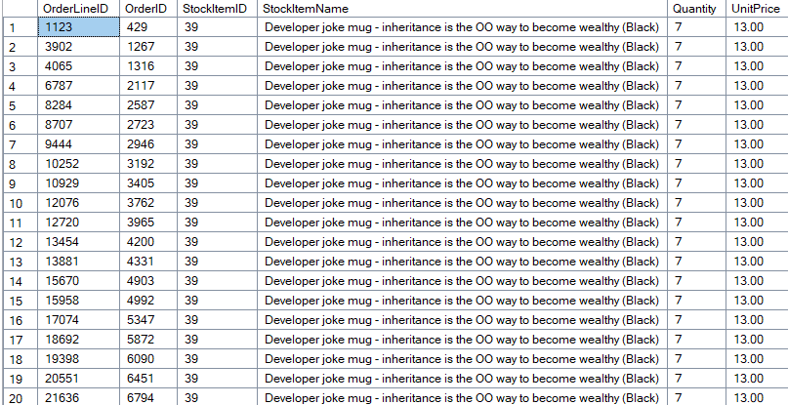
QUERY 2
USE WideWorldImporters;
GO
SELECT
ol.OrderLineID,
ol.OrderID,
ol.StockItemID,
si.StockItemName,
ol.Quantity,
ol.UnitPrice
FROM Warehouse.StockItems AS si
RIGHT JOIN Sales.OrderLines AS ol
ON si.StockItemID = ol.StockItemID
ORDER BY ol.OrderID;
Shows detailed order line information, including product names, quantities, and unit prices.
RIGHT JOIN ensures all order lines are included, even if a product record is missing, exposing potential data gaps.
Highlights which products are most frequently ordered, helping guide inventory and stocking decisions.
Notes:
Renzo Salazar

Slide 38
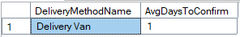
QUERY 3
USE WideWorldImporters;
GO
SELECT
dm.DeliveryMethodName,
AVG(DATEDIFF(day, i.InvoiceDate, i.ConfirmedDeliveryTime)) AS AvgDaysToConfirm
FROM Sales.Invoices AS i
INNER JOIN Application.DeliveryMethods AS dm
ON dm.DeliveryMethodID = i.DeliveryMethodID
WHERE i.ConfirmedDeliveryTime IS NOT NULL
GROUP BY dm.DeliveryMethodName
ORDER BY AvgDaysToConfirm;
Using this query we can measure the average time between when an invoice gets issued and when the delivery gets confirmed.
The result of this query shows how quickly are orders being confirmed.
We can see the methods that was used for delivery and how successful it is. Shown is that the average days to confirm is 1, which means our customers are very happy of our quick service.
Notes:
Renzo Salazar

Slide 39
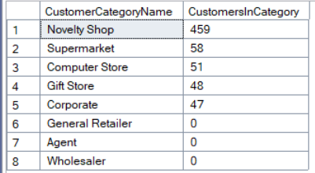
QUERY 4
USE WideWorldImporters;
GO
SELECT
cc.CustomerCategoryName,
COUNT(c.CustomerID) AS CustomersInCategory
FROM Sales.CustomerCategories AS cc
LEFT JOIN Sales.Customers AS c
ON c.CustomerCategoryID = cc.CustomerCategoryID
GROUP BY cc.CustomerCategoryName
ORDER BY CustomersInCategory DESC;
Groups customers by category and counts how many we have per each category.
LEFT JOIN ensures even categories with no customers still appear, as shown on the table.
Using this data, we can prioritize where we are falling behind and where our focus should be.
Notes:
Renzo Salazar

Slide 40
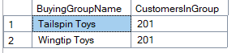
QUERY 5
USE WideWorldImporters;
GO
SELECT
bg.BuyingGroupName,
COUNT(c.CustomerID) AS CustomersInGroup
FROM Sales.BuyingGroups AS bg
LEFT JOIN Sales.Customers AS c
ON c.BuyingGroupID = bg.BuyingGroupID
GROUP BY bg.BuyingGroupName
ORDER BY CustomersInGroup DESC;
This query counts how many customers exist in each buying group.
We can use this information to see which customers we should be catering to or continuing or improving our business with.
Notes:
Renzo Salazar

Slide 41
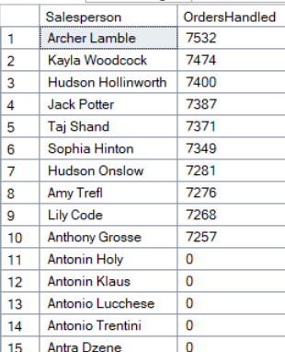
QUERY 6
USE WideWorldImporters;
GO
SELECT
p.FullName AS Salesperson,
COUNT(o.OrderID) AS OrdersHandled
FROM Application.People AS p
LEFT JOIN Sales.Orders AS o
ON o.SalespersonPersonID = p.PersonID
GROUP BY p.FullName
ORDER BY OrdersHandled DESC;
This query gives us the order count per sales person
Highlights the workload that each sales person handles.
Using a LEFT JOIN, we can see even sales people who have handled 0 orders.
Data could prove useful if one sales person carries too much of the workload, and can be distributed to other staff.
Notes:
Renzo Salazar

Slide 42
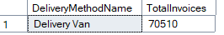
QUERY 7
USE WideWorldImporters;
GO
SELECT
dm.DeliveryMethodName,
COUNT(*) AS TotalInvoices
FROM Sales.Invoices AS i
INNER JOIN Application.DeliveryMethods AS dm
ON dm.DeliveryMethodID = i.DeliveryMethodID
GROUP BY dm.DeliveryMethodName
ORDER BY TotalInvoices DESC;
Counts the amount of total invoices, and finds how they were delivered.
Puts them in order of greatest to smallest to see what the most common method of transportation was.
Notes:
Renzo Salazar

Slide 43
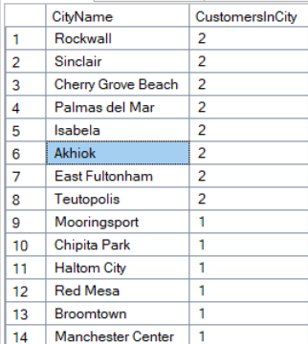
QUERY 8
Counts the amount of customers by the city orders were delivered to.
Data could be used to map out the geographic data of where our orders land the most.
This way we can better inform couriers or where to set up warehouse locations.
USE WideWorldImporters;
GO
SELECT
ac.CityName,
COUNT(c.CustomerID) AS CustomersInCity
FROM Application.Cities AS ac
LEFT JOIN Sales.Customers AS c
ON c.DeliveryCityID = ac.CityID
GROUP BY ac.CityName
ORDER BY CustomersInCity DESC;
Notes:
Renzo Salazar

Slide 44
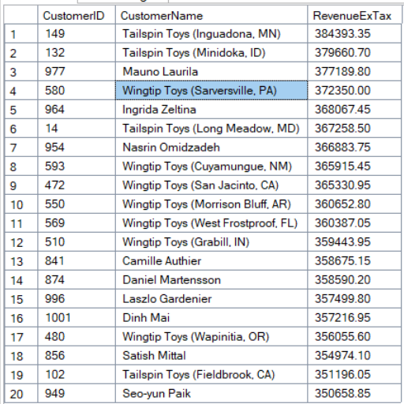
QUERY 9
USE WideWorldImporters;
GO
SELECT TOP (20)
c.CustomerID,
c.CustomerName,
SUM(ol.Quantity * ol.UnitPrice) AS RevenueExTax
FROM Sales.Orders AS o
INNER JOIN Sales.OrderLines AS ol
ON ol.OrderID = o.OrderID
INNER JOIN Sales.Customers AS c
ON c.CustomerID = o.CustomerID
GROUP BY c.CustomerID, c.CustomerName
ORDER BY RevenueExTax DESC;
This query ranks customers by the total amount that they spent.
Identifies customers that are helping us grow our business.
We can use this data to focus on keeping the accounts of the top customers that are bringing in the most business.
Notes:
Renzo Salazar

Slide 45
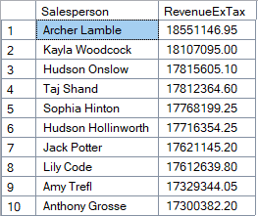
QUERY 10
USE WideWorldImporters;
GO
SELECT
p.FullName AS Salesperson,
SUM(ol.Quantity * ol.UnitPrice) AS RevenueExTax
FROM Sales.Orders AS o
INNER JOIN Sales.OrderLines AS ol
ON ol.OrderID = o.OrderID
INNER JOIN Application.People AS p
ON p.PersonID = o.SalespersonPersonID
GROUP BY p.FullName
ORDER BY RevenueExTax DESC;
Sums the revenue that each sales person brought in order from biggest to lowest.
We can combine this with the data from query 6 to find out who our top sales people are for performance reviews.
Notes:
Renzo Salazar

Slide 46
Nadia Islam

Slide 47
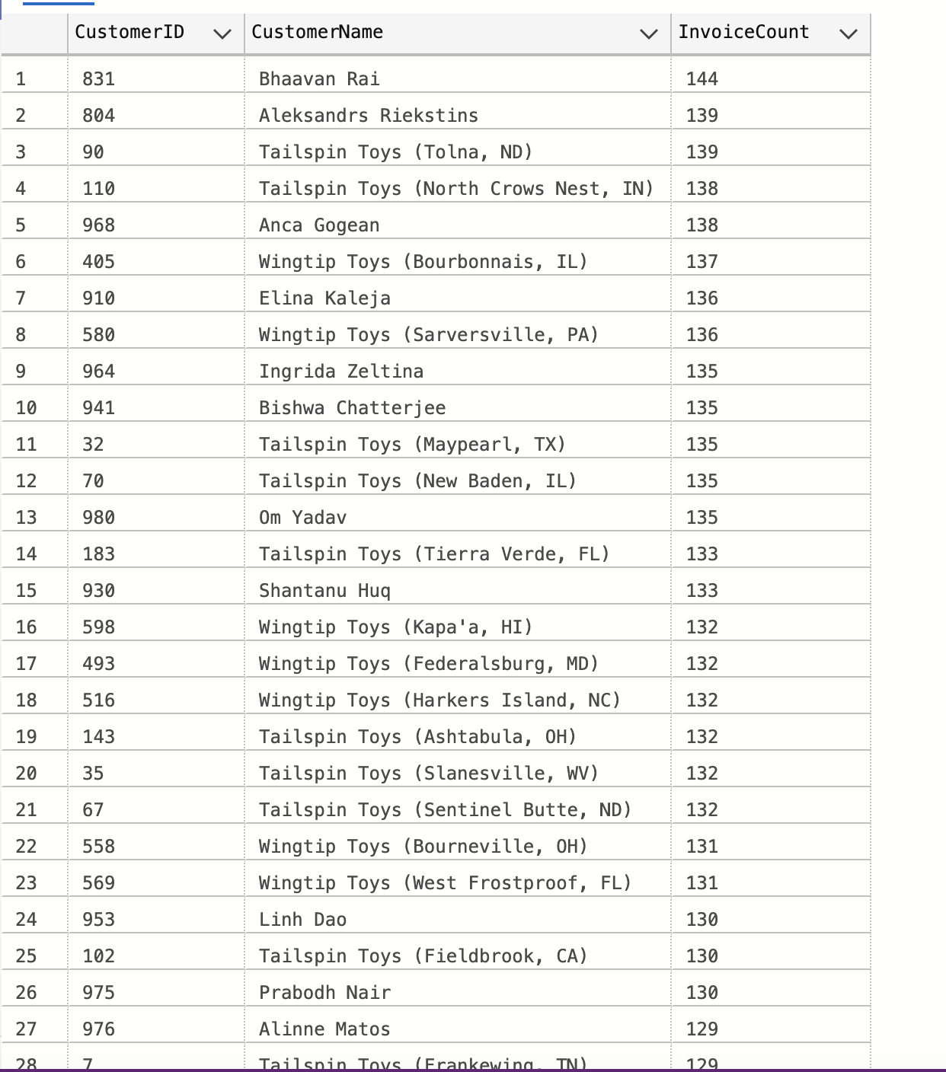
QUERY 1
SELECT i.CustomerID, c.CustomerName, COUNT(i.InvoiceID) AS InvoiceCount
FROM Sales.Invoices i
JOIN Sales.Customers c
ON i.CustomerID = c.CustomerID
GROUP BY i.CustomerID, c.CustomerName
ORDER BY InvoiceCount DESC;
Total number of invoices per customer
Counts invoices for each customer
Notes:
Nadia Islam

Slide 48
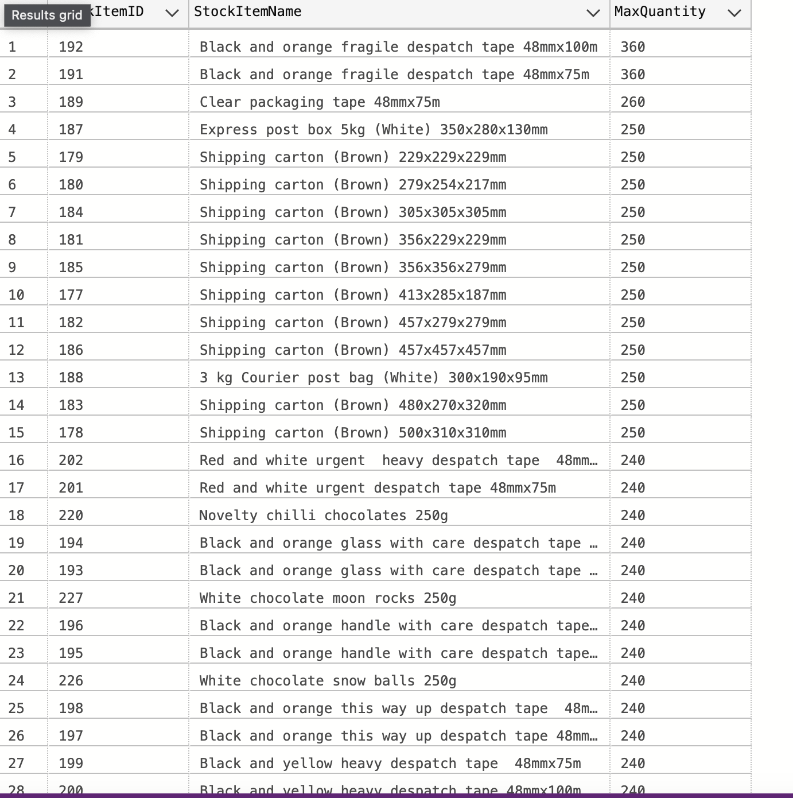
QUERY 2
SELECT il.StockItemID, si.StockItemName, MAX(il.Quantity) AS MaxQuantity
FROM Sales.InvoiceLines il
JOIN Warehouse.StockItems si
ON il.StockItemID = si.StockItemID
GROUP BY il.StockItemID, si.StockItemName
ORDER BY MaxQuantity DESC;
Highest quantity sold per product
Maximum quantity sold in one invoice line for each product
Notes:
Nadia Islam

Slide 49
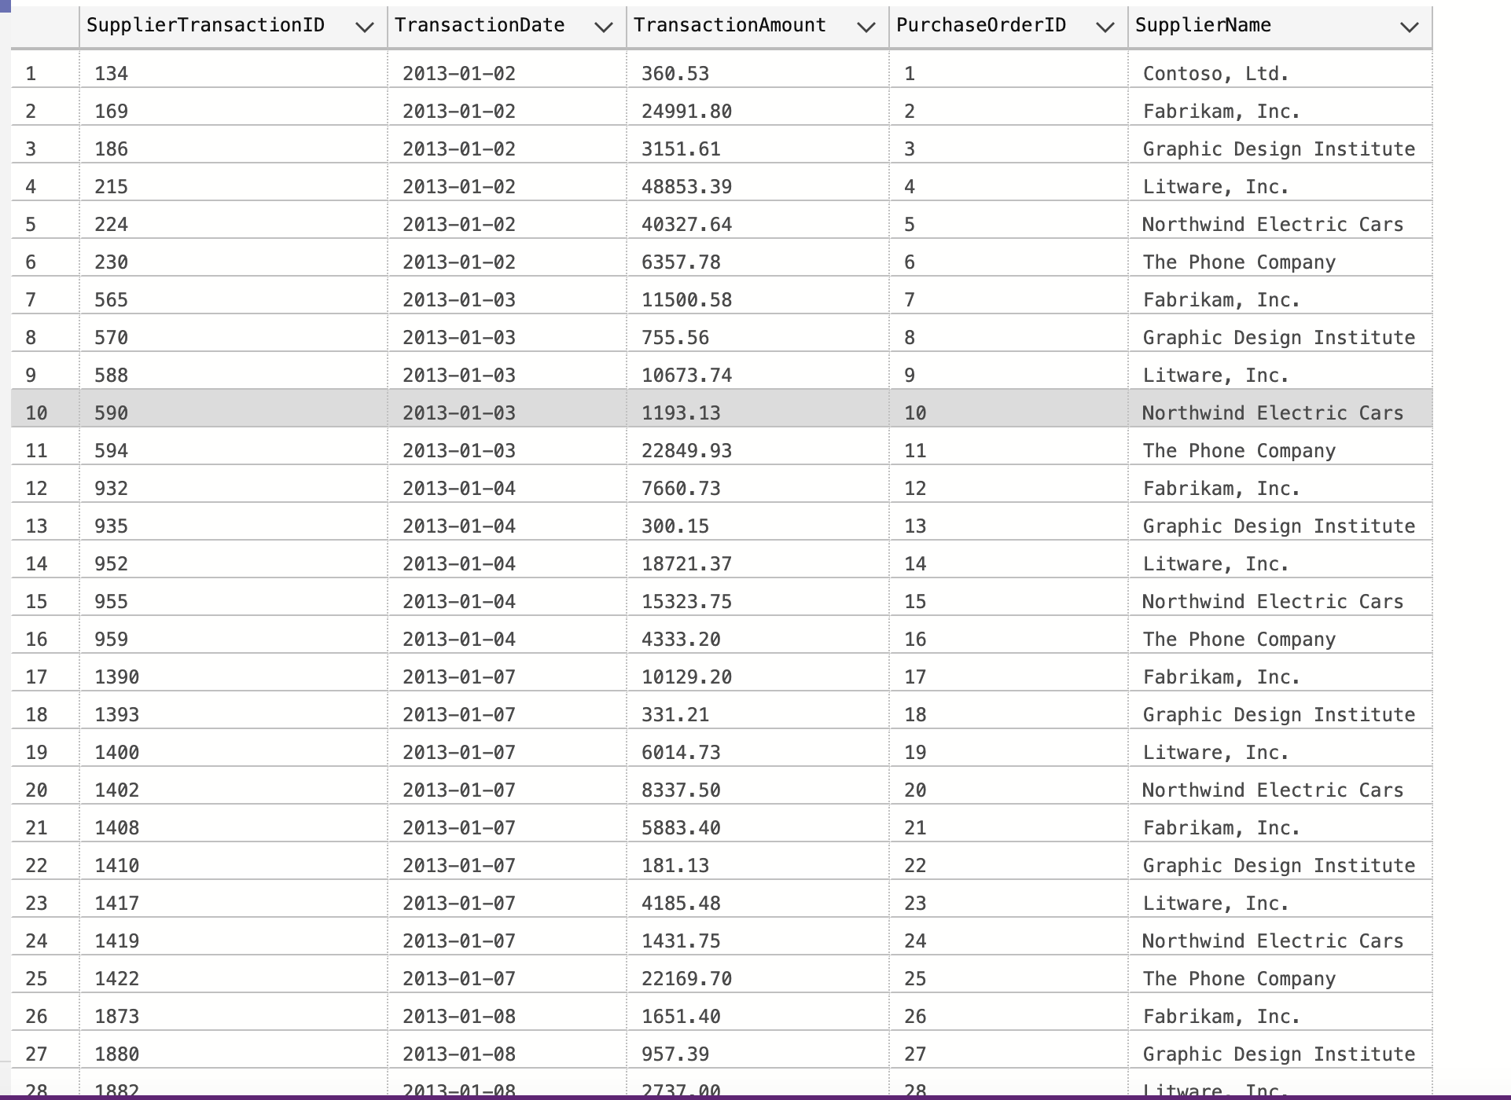
QUERY 3
SELECT st.SupplierTransactionID, st.TransactionDate, st.TransactionAmount, po.PurchaseOrderID, s.SupplierName
FROM Purchasing.SupplierTransactions st
JOIN Purchasing.PurchaseOrders po
ON st.PurchaseOrderID = po.PurchaseOrderID
JOIN Purchasing.Suppliers s
ON st.SupplierID = s.SupplierID
ORDER BY st.TransactionDate;
Supplier transactions linked to purchase orders
Transaction amounts for purchase orders with supplier info
Notes:
Nadia Islam

Slide 50
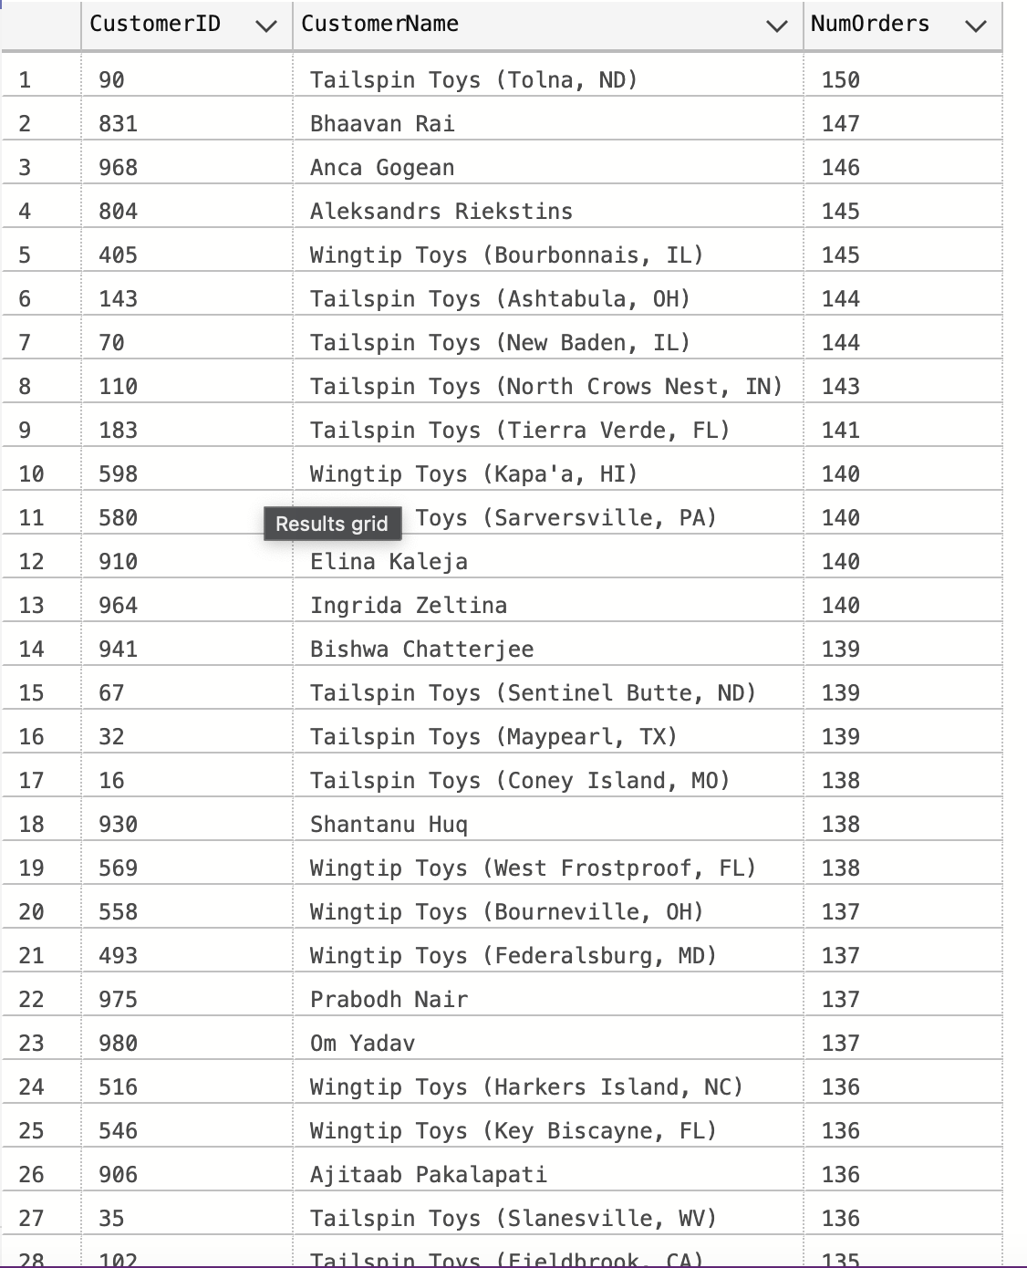
QUERY 4
SELECT o.CustomerID, c.CustomerName, COUNT(o.OrderID) AS NumOrders
FROM Sales.Orders o
JOIN Sales.Customers c
ON o.CustomerID = c.CustomerID
GROUP BY o.CustomerID, c.CustomerName
HAVING COUNT(o.OrderID) > 1
ORDER BY NumOrders DESC;
Customers with multiple orders
Customers with more than one order
Notes:
Nadia Islam

Slide 51
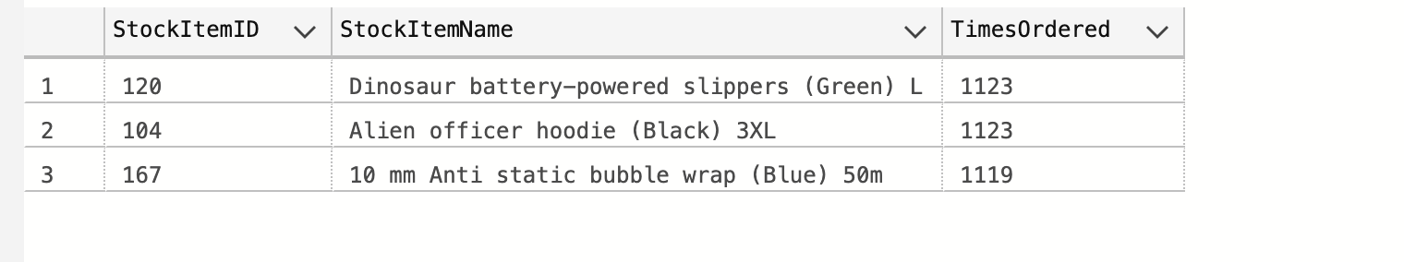
QUERY 5
SELECT ol.StockItemID, si.StockItemName, COUNT(*) AS TimesOrdered
FROM Sales.OrderLines ol
JOIN Warehouse.StockItems si
ON ol.StockItemID = si.StockItemID
GROUP BY ol.StockItemID, si.StockItemName
ORDER BY TimesOrdered DESC
OFFSET 0 ROWS FETCH NEXT 3 ROWS ONLY;
Top 3 most frequently ordered products
Products appearing most across all orders
Notes:
Nadia Islam

Slide 52
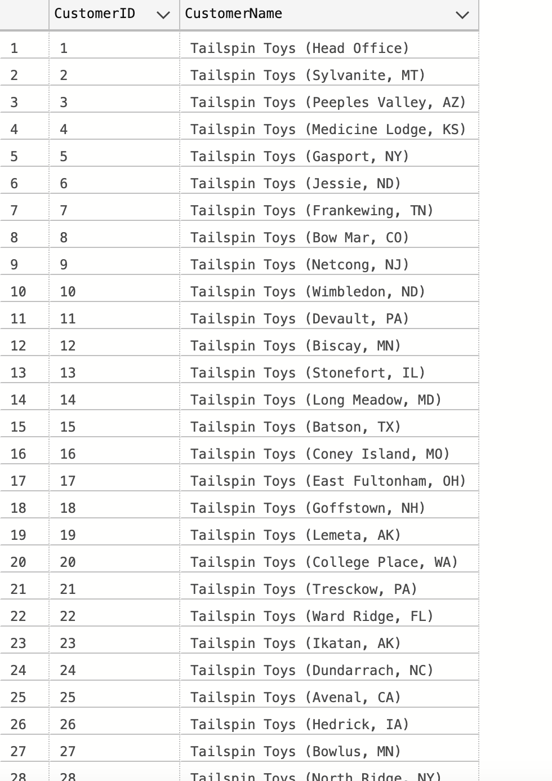
QUERY 6
SELECT DISTINCT o.CustomerID, c.CustomerName
FROM Sales.Orders o
JOIN Sales.Customers c
ON o.CustomerID = c.CustomerID
LEFT JOIN Sales.Invoices i
ON o.OrderID = i.OrderID
WHERE i.InvoiceID IS NULL;
Customers without invoices
Customers with orders but no invoices
Notes:
Nadia Islam

Slide 53
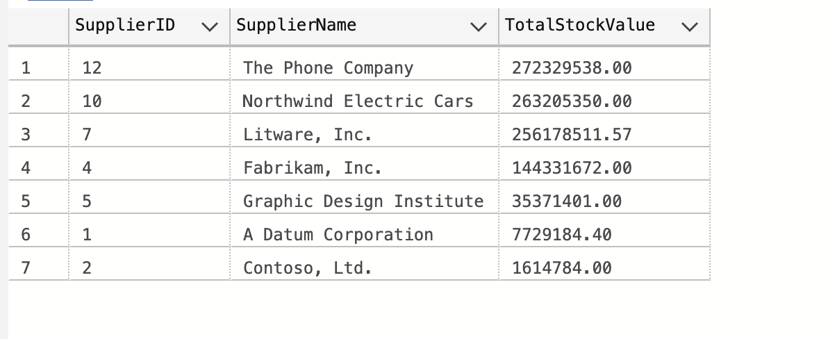
QUERY 7
SELECT si.SupplierID, s.SupplierName, SUM(sih.QuantityOnHand * si.UnitPrice) AS TotalStockValue
FROM Warehouse.StockItems si
JOIN Warehouse.StockItemHoldings sih
ON si.StockItemID = sih.StockItemID
JOIN Purchasing.Suppliers s
ON si.SupplierID = s.SupplierID
GROUP BY si.SupplierID, s.SupplierName
ORDER BY TotalStockValue DESC;
Total stock value per supplier
Total stock value grouped by supplier
Notes:
Nadia Islam

Slide 54
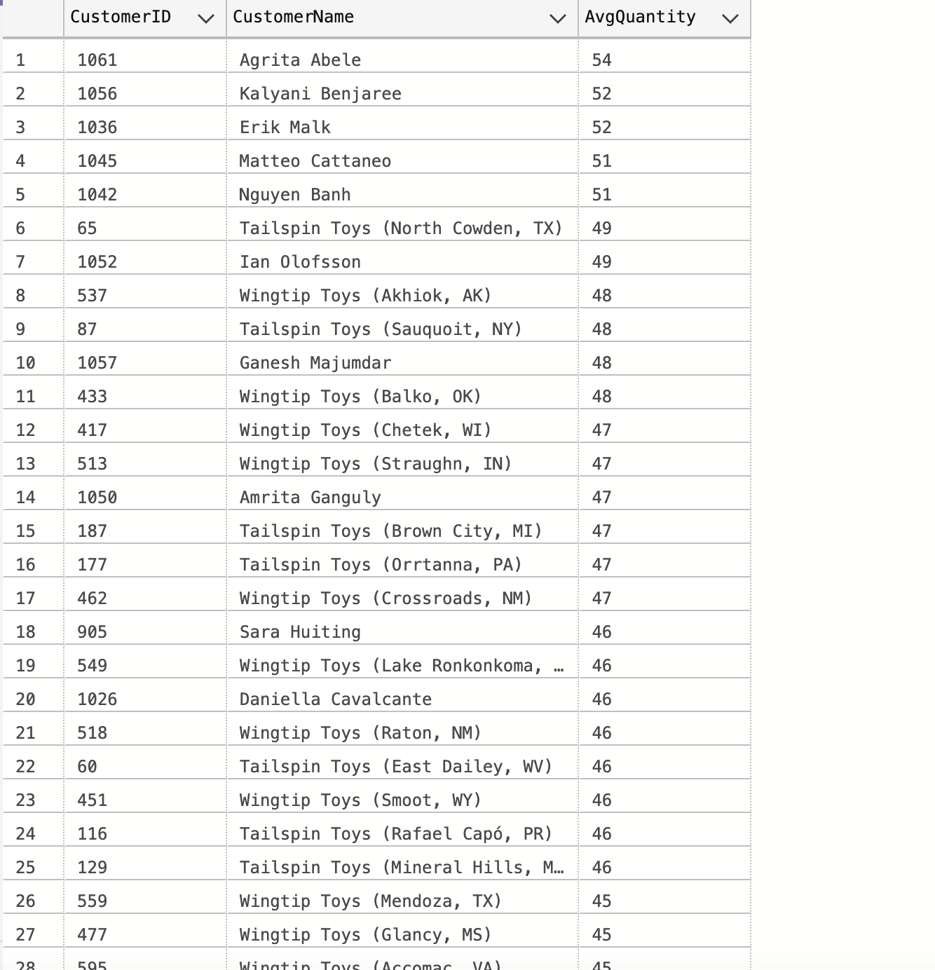
QUERY 8
SELECT o.CustomerID, c.CustomerName, AVG(ol.Quantity) AS AvgQuantity
FROM Sales.Orders o
JOIN Sales.OrderLines ol
ON o.OrderID = ol.OrderID
JOIN Sales.Customers c
ON o.CustomerID = c.CustomerID
GROUP BY o.CustomerID, c.CustomerName
ORDER BY AvgQuantity DESC;
Average order quantity per customer
Average quantity per order for each customer
Notes:
Nadia Islam

Slide 55
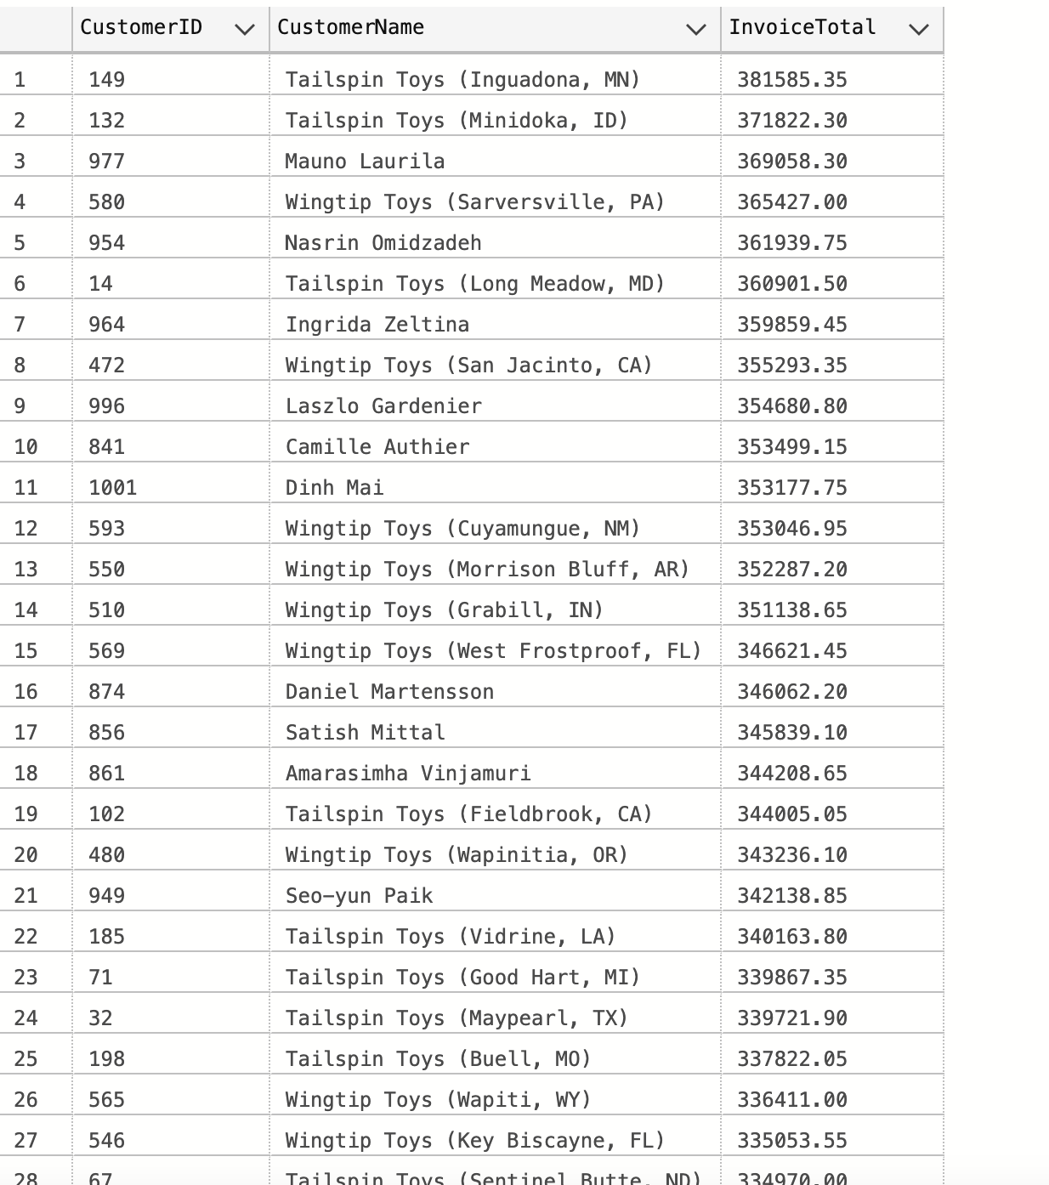
QUERY 9
SELECT i.CustomerID, c.CustomerName, SUM(il.Quantity * ISNULL(il.UnitPrice,0)) AS InvoiceTotal
FROM Sales.Invoices i
JOIN Sales.InvoiceLines il
ON i.InvoiceID = il.InvoiceID
JOIN Sales.Customers c
ON i.CustomerID = c.CustomerID
GROUP BY i.CustomerID, c.CustomerName
HAVING SUM(il.Quantity * ISNULL(il.UnitPrice,0)) > 10000
ORDER BY InvoiceTotal DESC;
Customers with invoices over a threshold
Customers with invoice totals over $10,000
Notes:
Nadia Islam

Slide 56
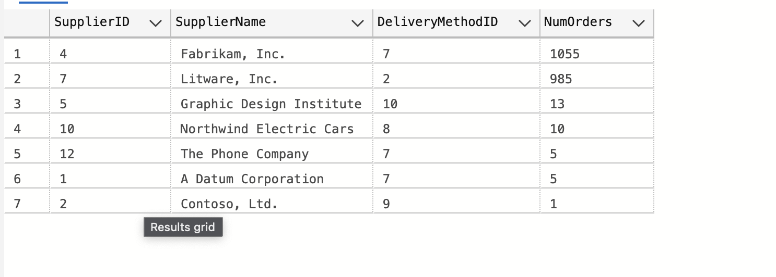
QUERY 10
SELECT po.SupplierID, s.SupplierName, po.DeliveryMethodID, COUNT(po.PurchaseOrderID) AS NumOrders
FROM Purchasing.PurchaseOrders po
JOIN Purchasing.Suppliers s
ON po.SupplierID = s.SupplierID
GROUP BY po.SupplierID, s.SupplierName, po.DeliveryMethodID
ORDER BY NumOrders DESC;
Supplier orders by delivery method
Number of purchase orders per supplier per delivery method
Notes:
Nadia Islam

